Slide 1
Notes:
All right so

Slide 2
From Mentorship to Mastery: Navigating my way from Mentorship to Full-Time Kernel Developer
Anup Sharma
Open Source Developer
Notes:
hello everyone my name is Anup a open source developer and today i will be talking about How LFX mentorship helped me to being a full time kernel developer.

Slide 3
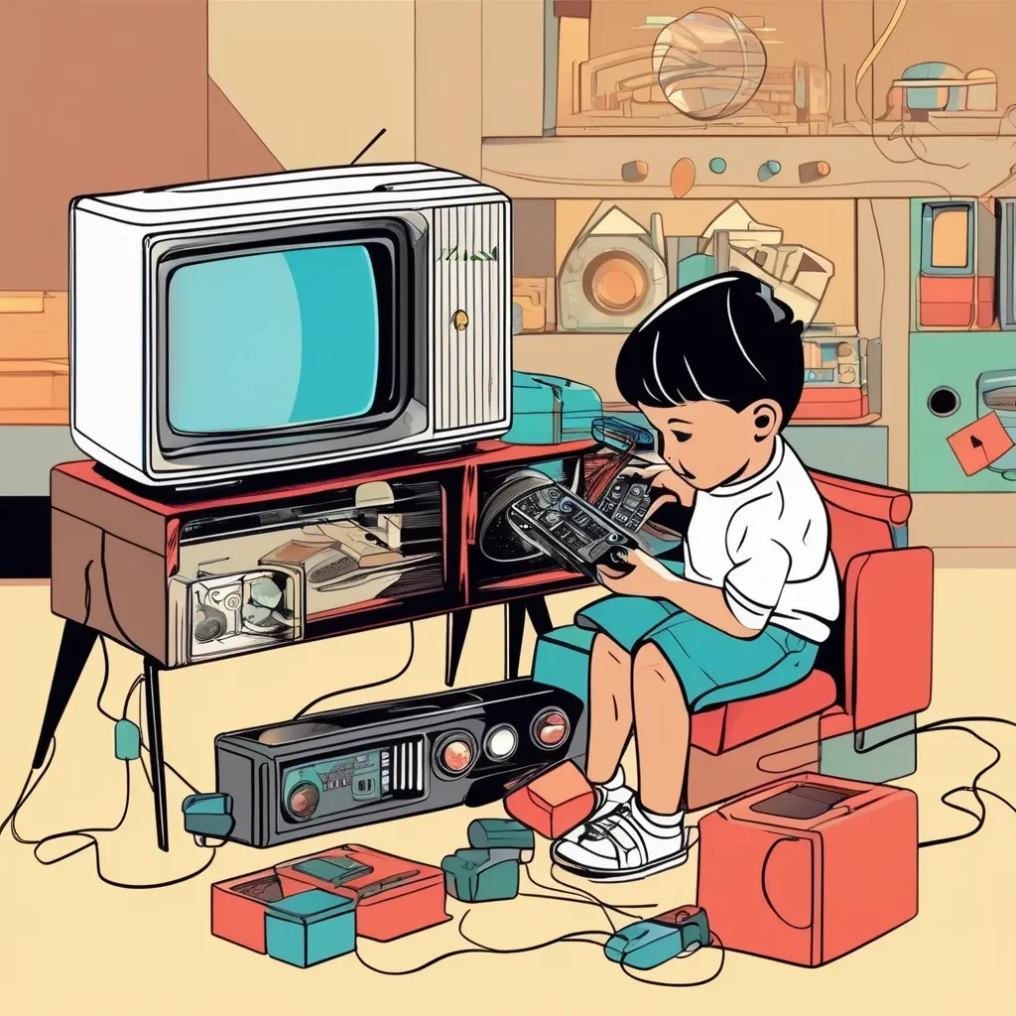

/?whoami
“Deeply
Passionate about
the fusion of
hardware and
low-level programming,
where every bit and
instruction counts.”
Hi I am Anup 👋
@anup-sharma1
Notes:
My passion for electronics and computers started at a very young age. Soon after I got my first computer, I started writing low-level codes, experimenting with microcontrollers and sensors which eventually turned my iterations into projects.

Slide 4
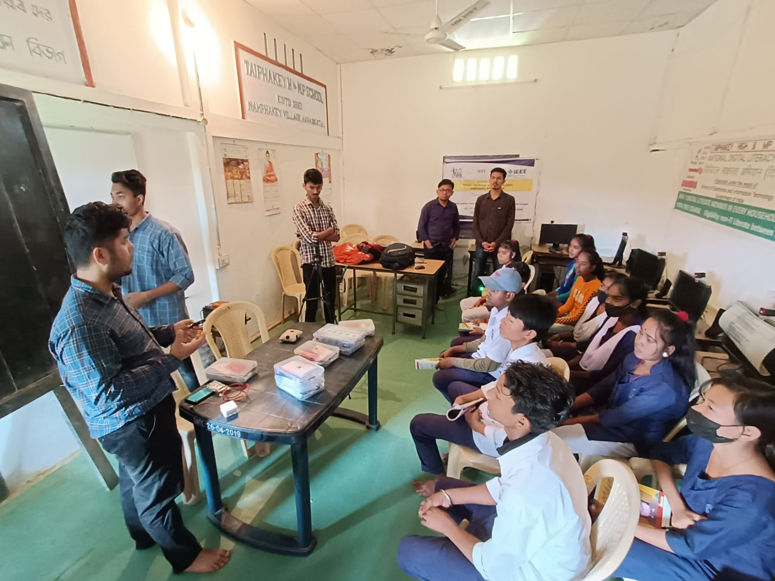
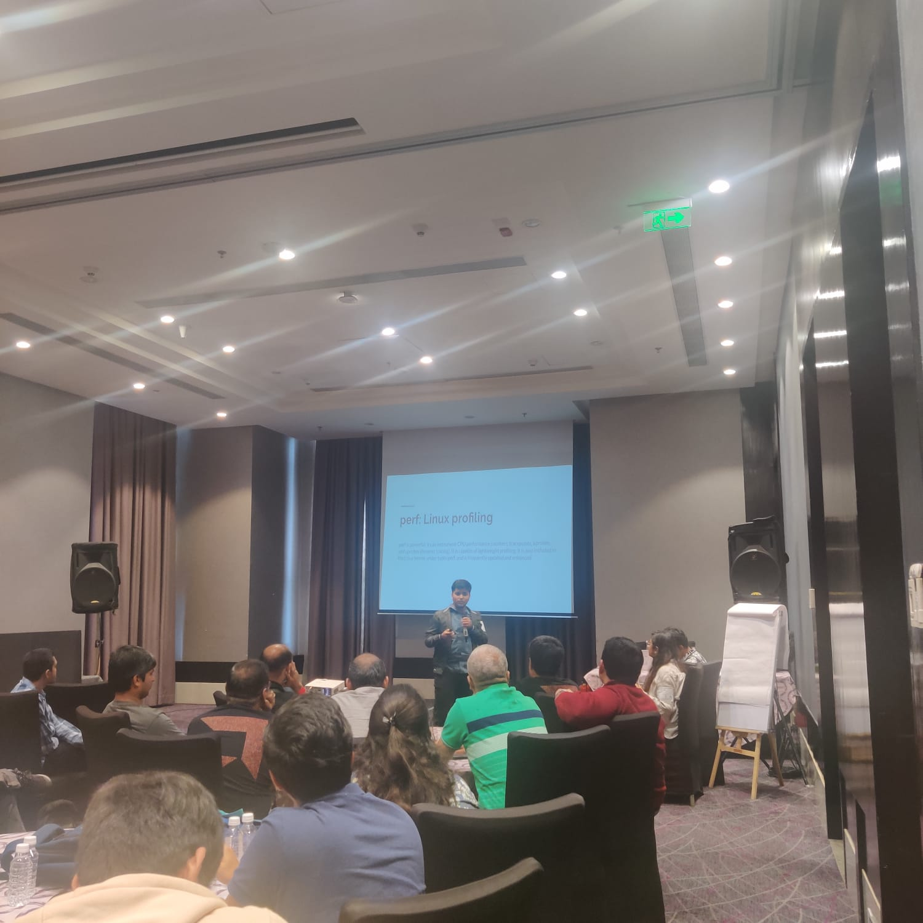
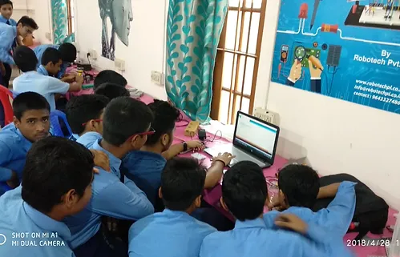
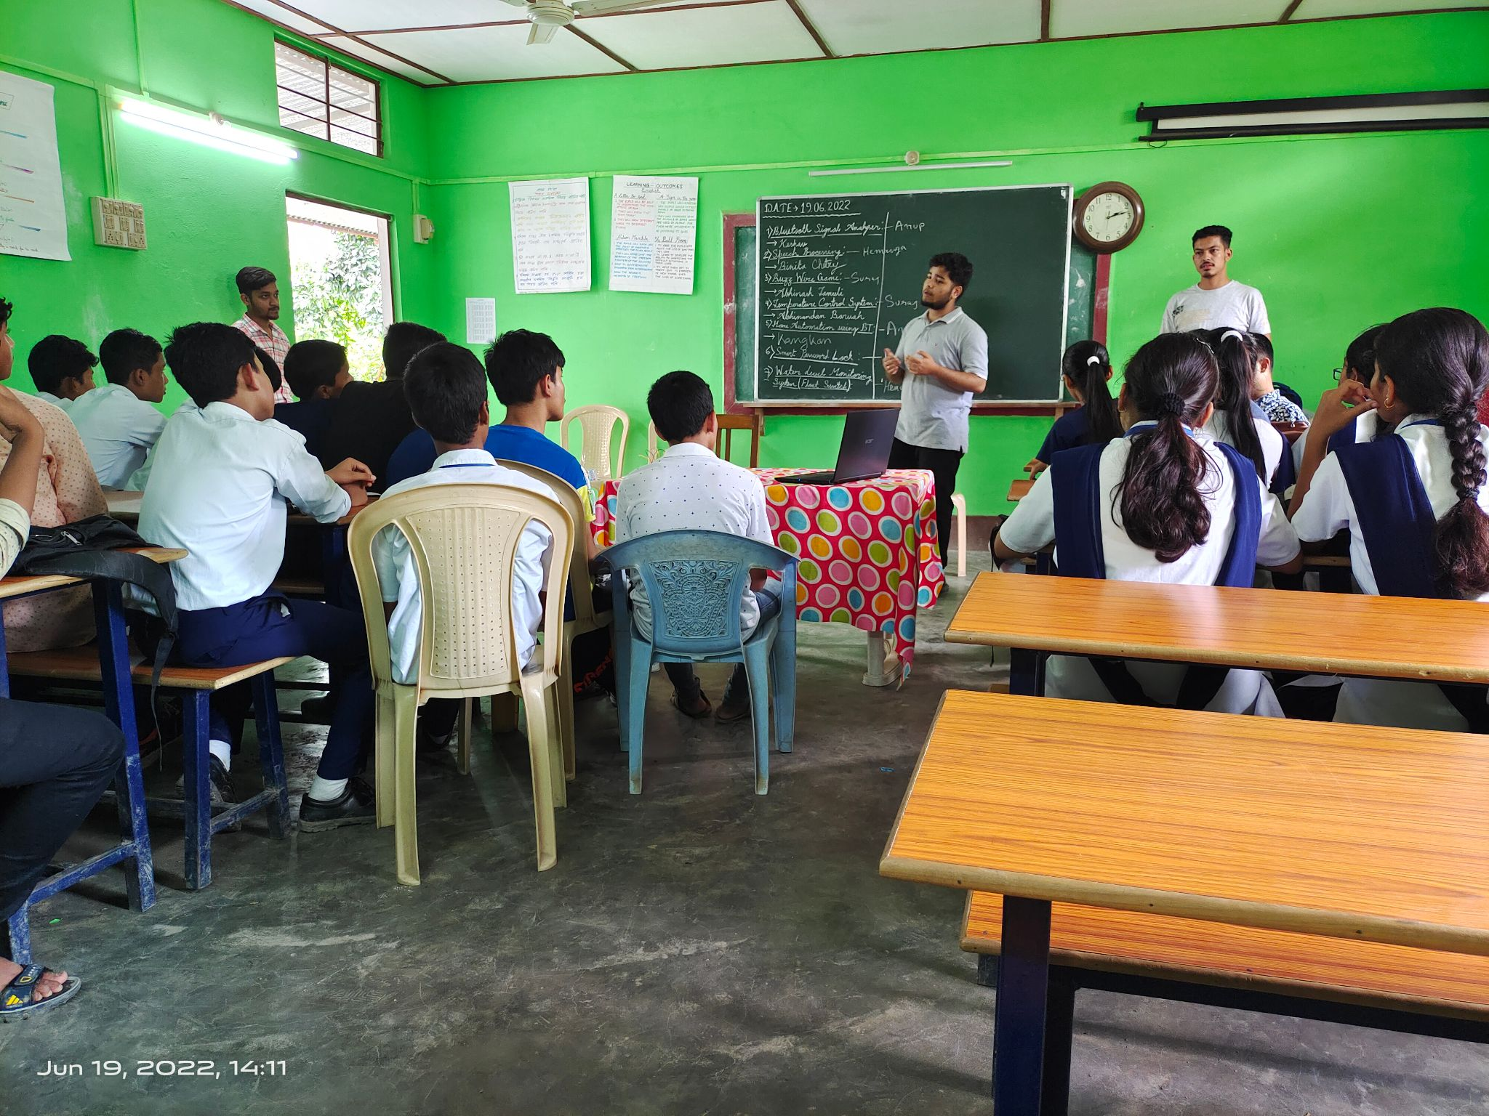
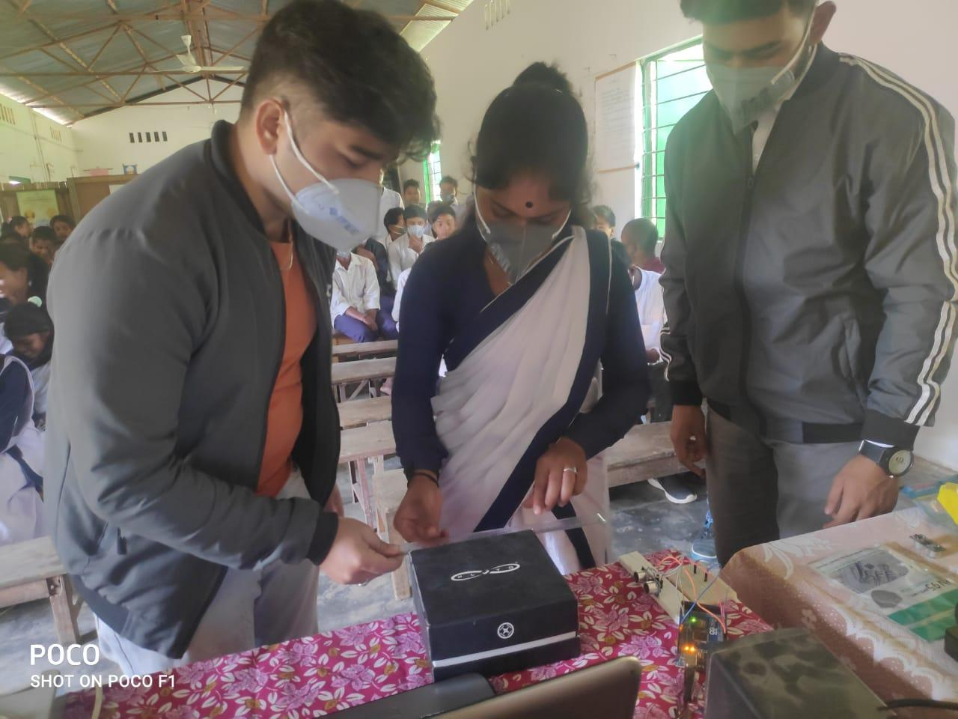
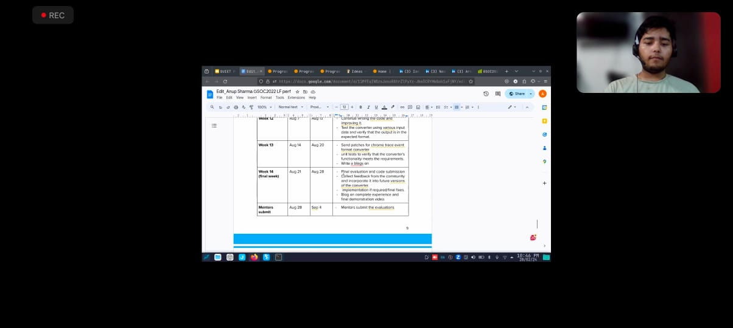
$cat ~/.bash_history
Notes:
And very offen, in my free time…You will also find me, mentoring students, specially rural kids in India, and I have been doing this from past several year in collaboration with various org like IEEE.

Slide 5

$cat ~/.bash_history
Notes:
However, when as a junior developer like me think of start working on a open source project often large project. The code base can feel quite big and this is what it feels like to navigate it,, you're going through a infinite stairs and you know what to find but you really don't know how long it will take and to where you get, eventually and you might end up

Slide 6

$:q!
Notes:
in something like this you juggling through many thoughts,,,,.

Slide 7
$echo “challenges.md”
First time contributing to open source.
I felt that I will not be able to complete the project.
The project and the workflow was completely new to me and I got scared.
Often hear from the community, Linux Kernel contribution can be very tough with the high bar.
Understanding the repo and finding the repo
Notes:
So when I started with LFX mentorship this were few of the challenges that I faced: As it was my first time into open source contribution
I felt that I will not be able to complete the project.
The project and the workflow was completely new to me and I got scared.
Often hear from people, Linux Kernel contribution is tough.
Understanding the kernel internals and finding the subsystem to contribute was a greatest challenge for me.

Slide 8
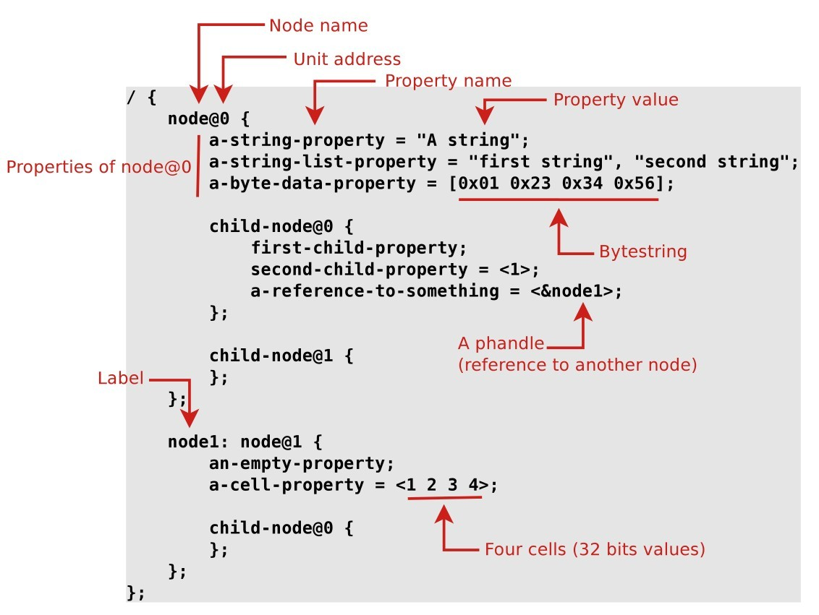
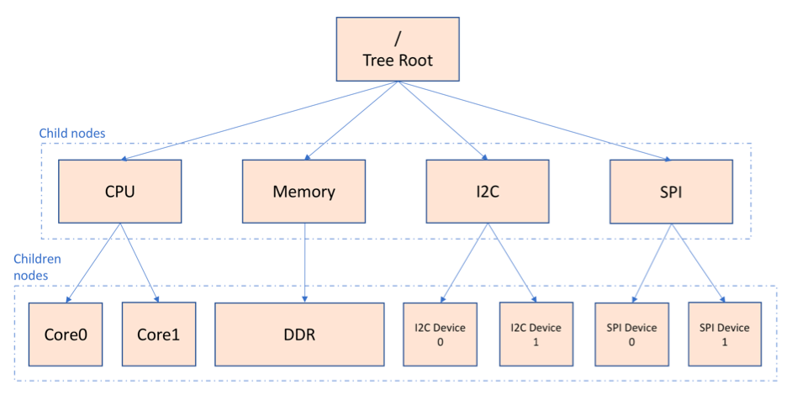
$echo “learnings.md”
A device tree is a tree data structure and language for describing hardware.
Notes:
Thats where I started looking at DT binding. So, a device tree is a tree data structure and language for describing hardware. What it does do is provide a language for decoupling the hardware configuration from the board and device driver support in the Linux kernel. Using it allows board and device support to become data driven; to make setup decisions based on data passed into the kernel instead of on per-machine hard coded selections. Explaining the diagrams

Slide 9
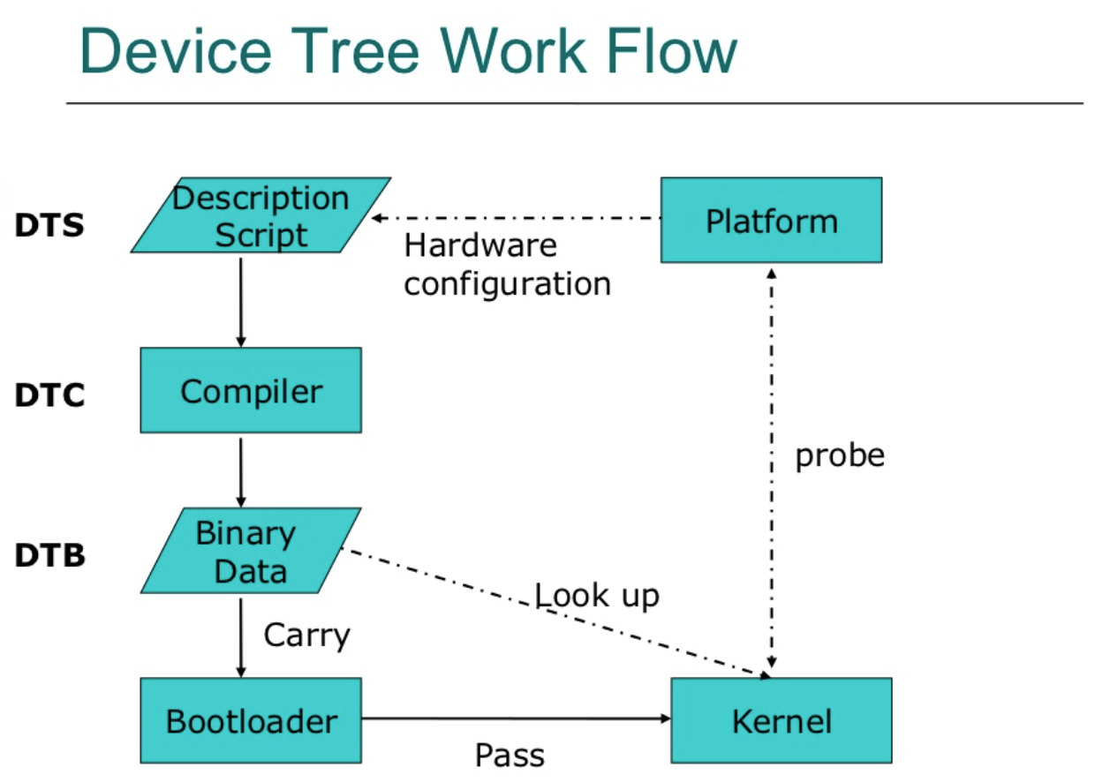
Notes:
Once you have the DTS file, the next step is to compile it into a binary device tree blob (*.dtb) file. The compilation process involves using the Device Tree Compiler (dtc) tool provided with the Linux kernel source code. If you want to perform a standalone compilation of your device tree and generate the blob file to be deployed on your Linux distribution, you need to use the DTC tool and the make command, as shown in the command below. If you're working with a bootloader (like U-Boot), you can load the compiled .dtb file as part of the boot process.

Slide 10
$Grep “My Mentoring Experience”
How we worked together
We had a sync up weekly on zoom and even shared code snippets.
I ask all my doubt and community at discord was really helpful. Even till today the community has been helpful.
They took away my fears that occured due to my lack of knowledge and
experience.
LFX Mentors
• I was mentored by Shuah Khan, Linux fellow and maintainer.
• Also mentored by Himadri Chhaya-Shailesh, Linux kernel contributor
Lifelong mentors:
Siddharth
Mehboob
Atul
Haraprasad
Notes:
Every week, our team met on Zoom to sync up, where we not only discussed progress but also shared code snippets to tackle challenges together. Whenever I had doubts, I turned to our community on Discord, which has been incredibly supportive. Even today, they continue to offer valuable help and guidance. Their support was crucial in overcoming my initial fears, which stemmed from my lack of experience and knowledge.I would like to thanks my mentors …….

Slide 11
$echo “outcome.md”
Linux Kernel development process.
I got enough skills and experience to apply and get selected for GSoC 2023.
After LKMP and GSoC, I got an offer from various companies.
Turn this passion/hobby into a full time career.
Notes:
Through my involvement in the Linux Kernel development process, I gained the skills and experience necessary to apply for and be selected for GSoC 2023. Following my work on the Linux Kernel Mentorship Program (LKMP) and my GSoC project, I received offers from several companies. This journey has allowed me to turn my passion and hobby into a full-time career.

Slide 12
Thank you!
Anup Sharma
X: @AnupSha78798485

